Slide 1
Churn Prediction
Prepared by: Sonali S. Narharshettiwar

Slide 2
Agenda
Problem statement
Dataset overview
EDA
Data preprocessing
Model implementation
Demo
ROC curve comparison
Results
Azure machine learning
References

Slide 3
Problem Statement
Churn is simply defined as the number or percentage of customers lost within a specific period of time . In other words, the metric tracks how successful or not you have been at keeping your customers engaged . Using churn modelling dataset, an automated model can be developed to predict the factors behind churning of customer from company.

Slide 4
Dataset Overview
No. of rows : 10000
No. of columns : 14
No null values
No duplicate records present

Slide 5
Exploratory Data Analysis
Pie chart to know proportion of data for customer churned and retained
Histogram for tenure vs no. of customer exited or retained
CountPlot for categorical variable vs customer exited or retained
BoxPlot for continuous data variable

Slide 6
Data preprocessing
Drop unrequired columns
One hot encoding on gender and geography columns

Slide 7
Model Development
Neural Network
Machine learning Algorithms
1) Logistic regression 2) Logistic regression (degree 2) 3) Random Forest 4) XGBoost 5) Naive Bayes 6) Support vector machine (SVM) 7) KNN classifier 8) Stochastic gradient descent (SGD)

Slide 8


Slide 9
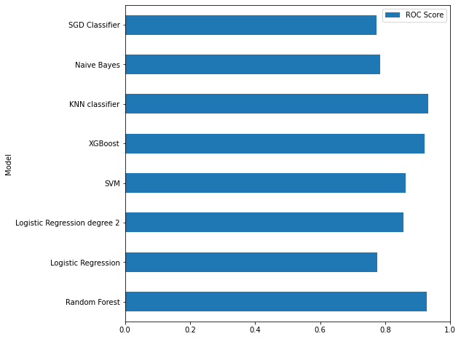
ROC Curve Comparison

Slide 10
Results
KNN Classifier is the best model for this dataset.
Random forest and XG Boost also has better result.
SVM, Naïve bayes , logistic regession,SGD Classifier has good result.

Slide 11
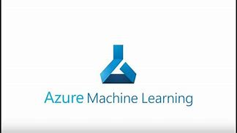
Model development using Azure ML
Azure Machine Learning is a cloud-based platform for building and operating machine learning solutions in Azure.
It includes a wide range of features and capabilities that help data scientists prepare data, train models, publish predictive services, and monitor their usage.
Azure ML can be used for regression, classification and time series problems.
Churn prediction is binary classification problem, so model can be trained using azure machine learning.

Slide 12
References
AI 101: Understanding Customer Churn Management | by Shamli Prakash | Towards Data Science
Predicting Churn for Bank Customers | Kaggle
https://www.analyticsvidhya.com/blog/2017/09/understaing-support-vector-machine-example-code
https://www.javatpoint.com/machine-learning-naive-bayes-classifier#:~:text=Na%C3%AFve%20Bayes%20Classifier%20is%20one,the%20probability%20of%20an%20object.
https://www.analyticsvidhya.com/blog/2015/09/random-forest-algorithm-multiple-challenges/?utm_source=blog&utm_medium=understandingsupportvectormachinearticle
https://machinelearningmastery.com/develop-first-xgboost-model-python-scikit-learn/
https://scikit-learn.org/stable/modules/sgd.html
https://scikit-learn.org/stable/modules/generated/sklearn.metrics.roc_auc_score.html
https://scikit-learn.org/stable/modules/generated/sklearn.model_selection.StratifiedKFold.html
https://developers.google.com/machine-learning/crash-course/classification/precision-and-recall

Slide 13
Thank You!!

